Slide 1
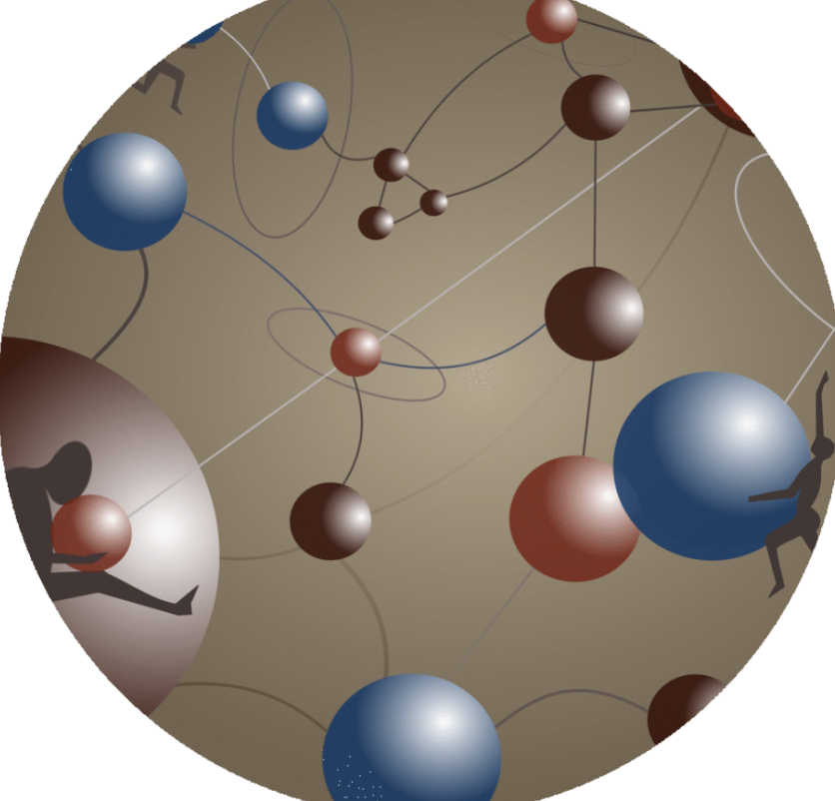
LECTURERS WITHOUT BORDERS
“Online Education Tools”
Webinar
30th of April, 17:00 CET.

Slide 2
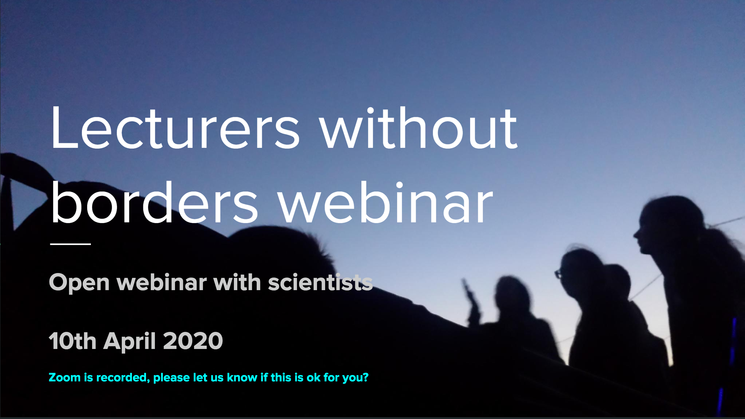
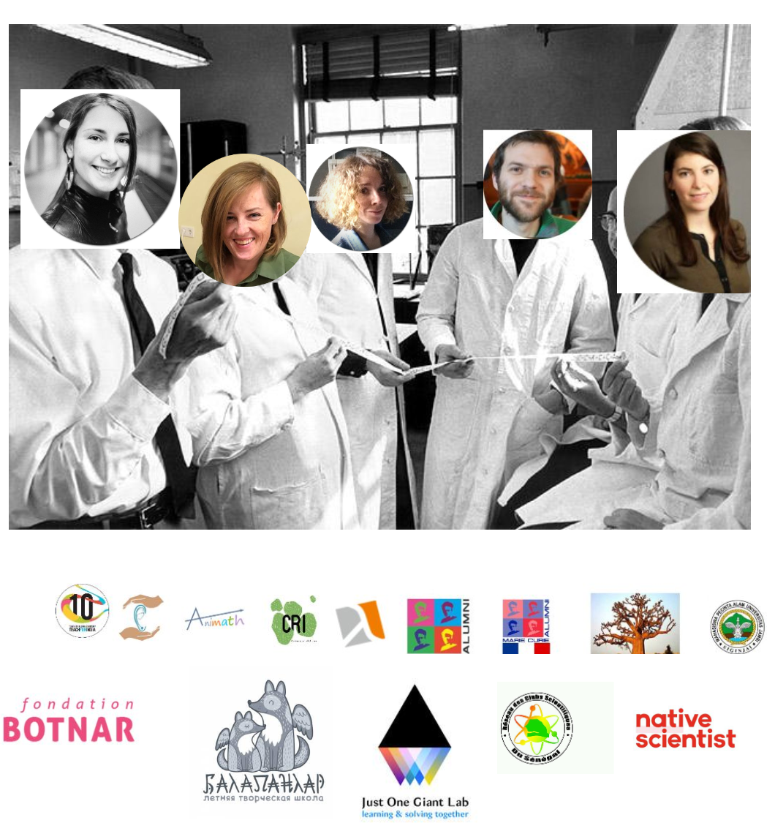
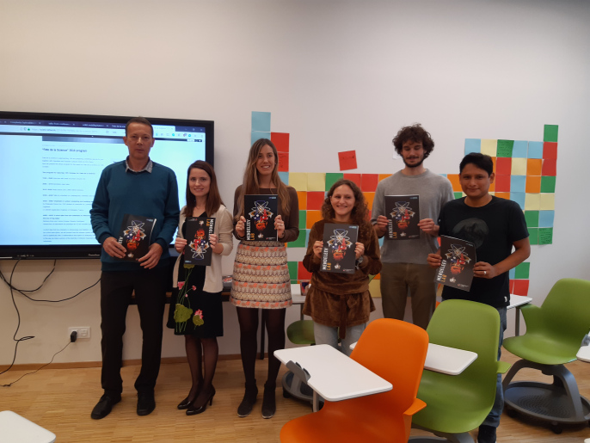
“Lecturers without borders”
“Online Education Tools” webinar, 30th of April, 17:00 CET.
Meet&Greet
What we do more
What we do
We have started to actively use online channels. Now we do webinars and online lectures.
Who we are
Before COVID we were using the current logistics to arrange free outreach lectures for high school and university students
LeWiBo – is a team of enthusiasts passionate about both science and education
Join us at scied.network

Slide 3
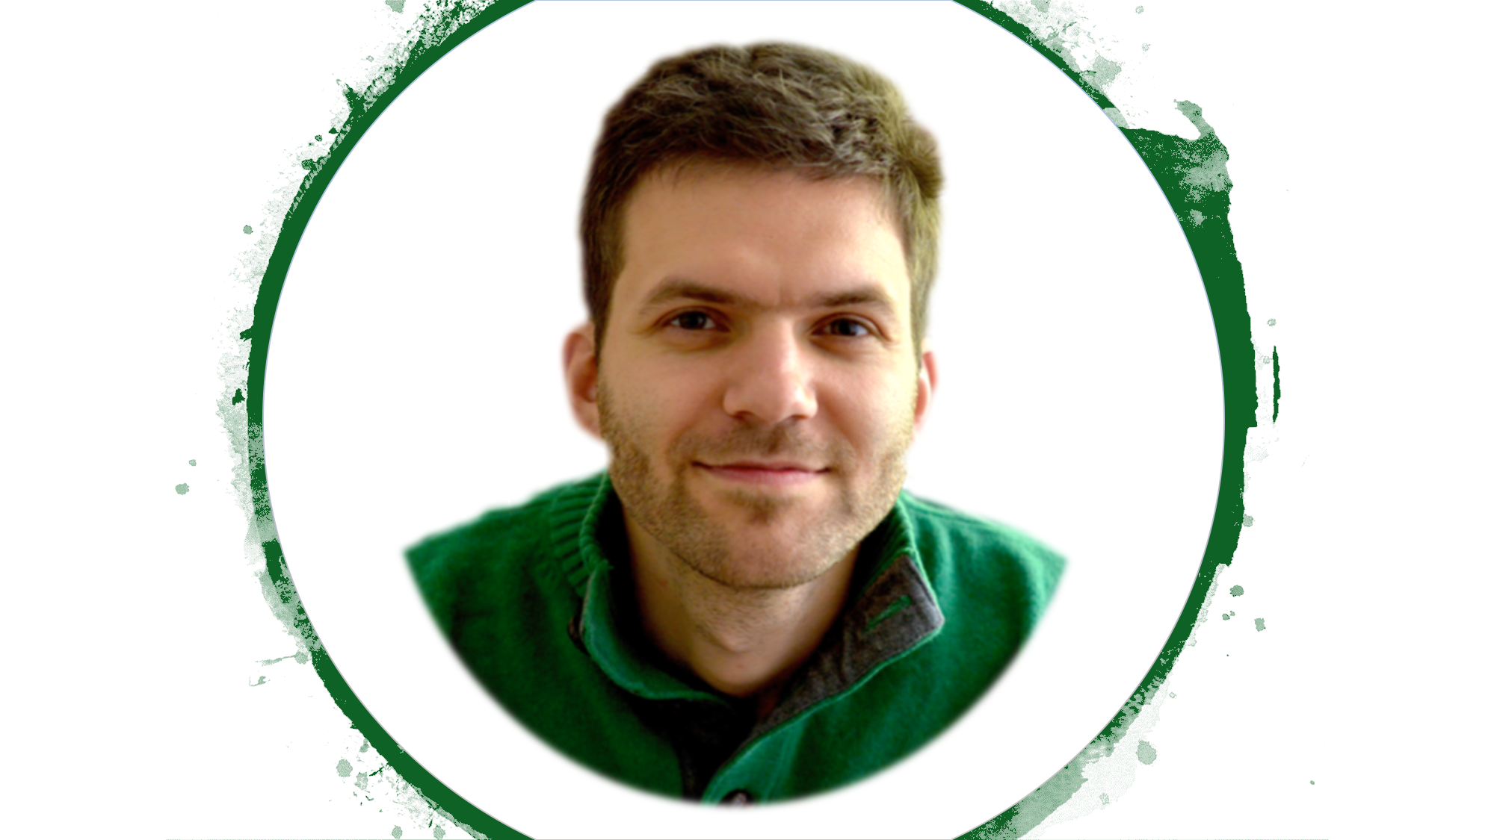

“Lecturers without borders”
“Online Education Tools” webinar, 30th of April, 17:00 CET.
Our Keynote
Speakers
Mikhail Khotyakov
MSc in Mathematics
Board member of Lecturers Without Borders
Math Teacher
Anna Balatel
PhD in Neuroeconomics
from University Ca'Foscari, Venice and University of Southern California, LA

Slide 4
“Lecturers without borders”
“Online Education Tools” webinar, 30th of April, 17:00 CET.
Useful Resources
Statistics before COVID
https://en.unesco.org/covid19/educationresponse/solutions
https://www.weareteachers.com/free-online-learning-resources
https://wabisabilearning.com/blogs/technology-integration/25-great-education-tools
And after COVID
The COVID-19 pandemic has forced school closures in 191 countries, affecting at least 1.5 billion students and 63 million primary and secondary teachers.
830 million learners globally do not have access to a computer. More than 40% have no Internet access at home.

Slide 5
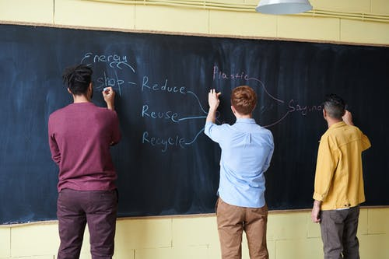

“Lecturers without borders”
“Online Education Tools” webinar, 30th of April, 17:00 CET.
10 Interactive Webinars
LANGUAGES:
English,
Spanish,
French
FOR
High school students
University Students
ABOUT
How to contribute
Find us on OpenCovid19 slack, Facebook, Twitter.
Join Lecturers without borders JOGL community.
To request a webinar for your institution, please use this form.
To participate as a lecturer, please email us!
An approved grant from JOGL

Slide 6
“Lecturers without borders”
“Online Education Tools” webinar, 30th of April, 17:00 CET.
Thank you!

